Slide 1
VERIFIED after this

Slide 2
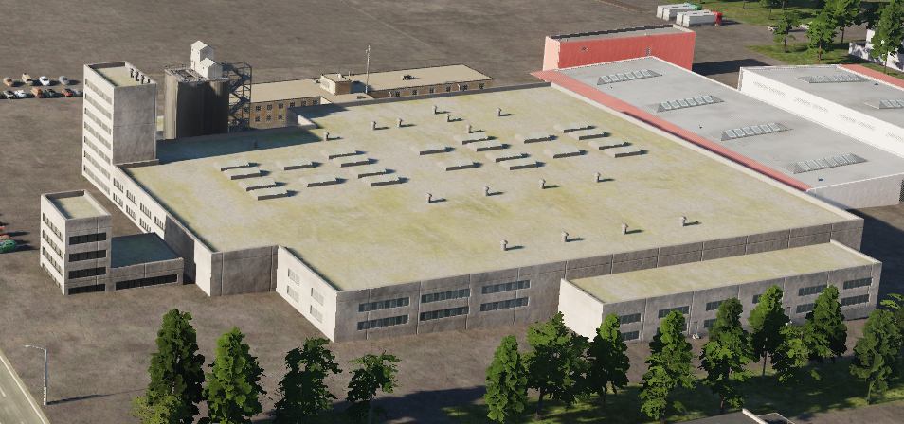
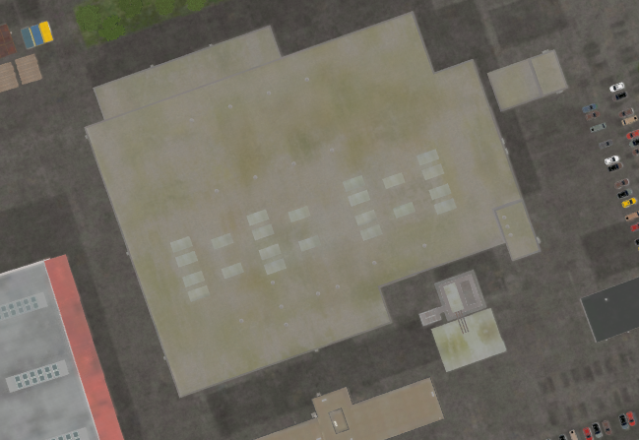
 | 500 IBS | 1000 IBS | 2000 IBS
1x Bomb
2x Bombs
4x Bombs
CHECK IF RUINS?

Slide 3
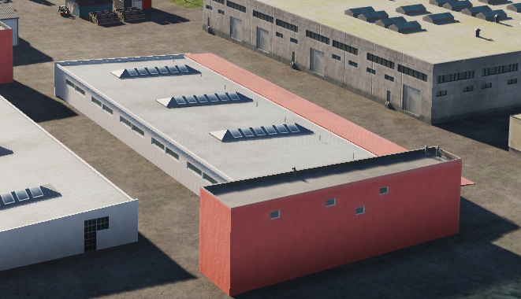
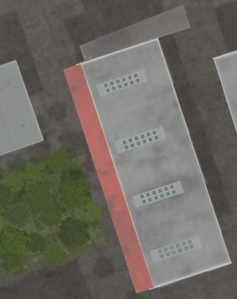
 | 500 IBS | 1000 IBS | 2000 IBS
1x Bomb
2x Bombs
4x Bombs
CHECK IF RUINS?

Slide 4
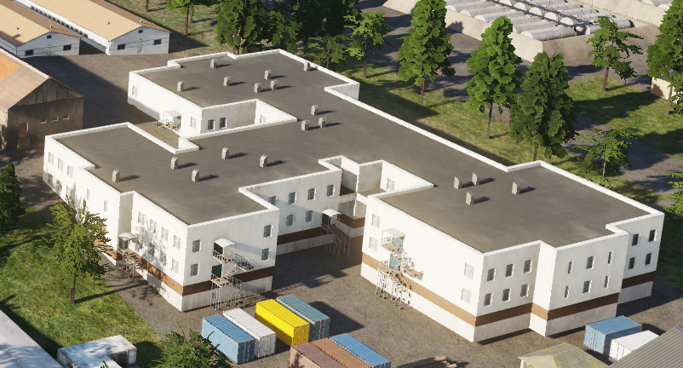
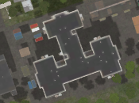
 | 500 IBS | 1000 IBS | 2000 IBS
1x Bomb
2x Bombs
4x Bombs
CHECK IF RUINS?

Slide 5
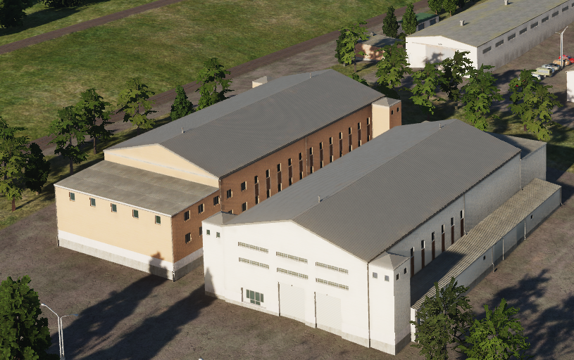
 | 500 IBS | 1000 IBS | 2000 IBS
1x Bomb
2x Bombs
4x Bombs
Same building, just different colors
Gives ruins

Slide 6
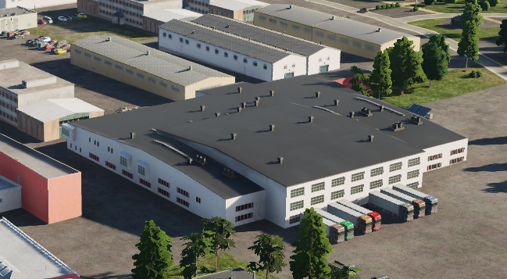
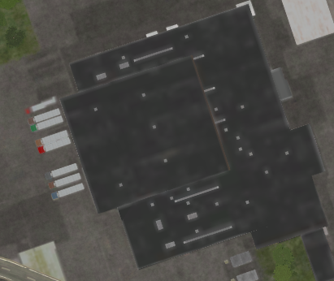
 | 500 IBS | 1000 IBS | 2000 IBS
1x Bomb
2x Bombs
4x Bombs
When destroyed, will be completely wiped from map, and will not give any ruins

Slide 7
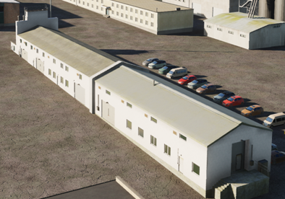
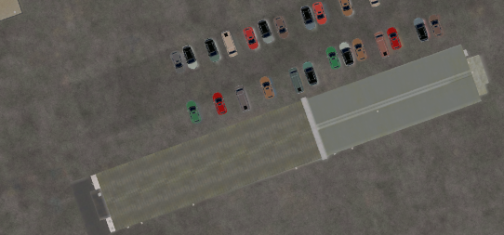
 | 500 IBS | 1000 IBS | 2000 IBS
1x Bomb
2x Bombs
4x Bombs
Gives ruins

Slide 8
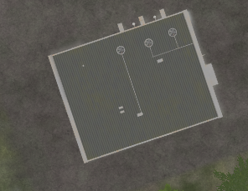
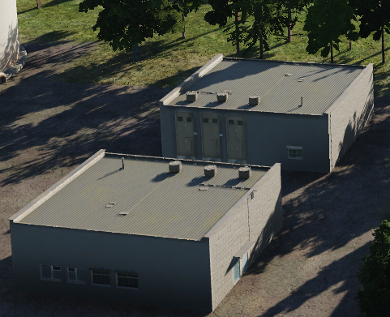
 | 500 IBS | 1000 IBS | 2000 IBS
1x Bomb
2x Bombs
4x Bombs
Gives ruins

Slide 9
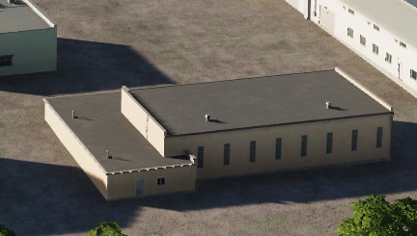
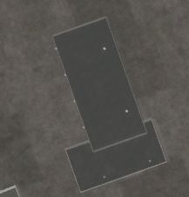
 | 500 IBS | 1000 IBS | 2000 IBS
1x Bomb
2x Bombs
4x Bombs

Slide 10
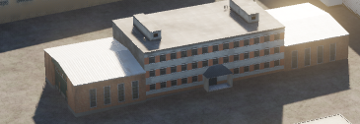
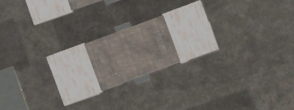
 | 500 IBS | 1000 IBS | 2000 IBS
1x Bomb
2x Bombs
4x Bombs
Gives ruins

Slide 11
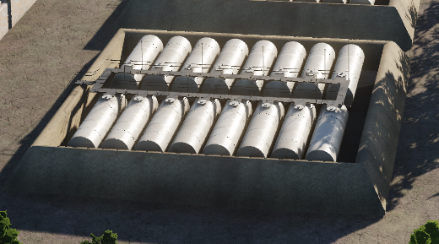
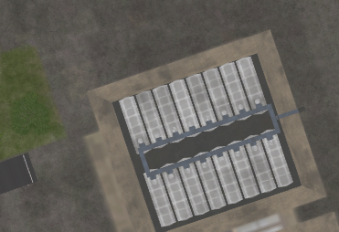
 | 500 IBS | 1000 IBS | 2000 IBS
1x Bomb
2x Bombs
4x Bombs
Gives ruins

Slide 12
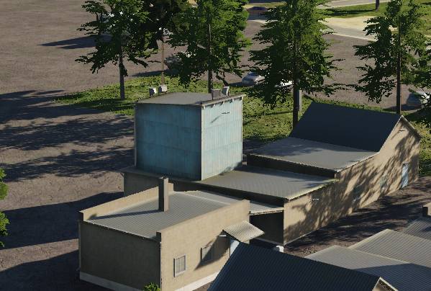
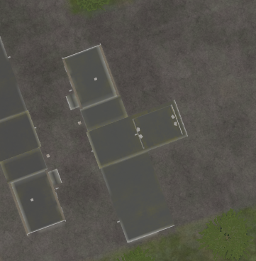
 | 500 IBS | 1000 IBS | 2000 IBS
1x Bomb
2x Bombs
4x Bombs
Gives ruins

Slide 13
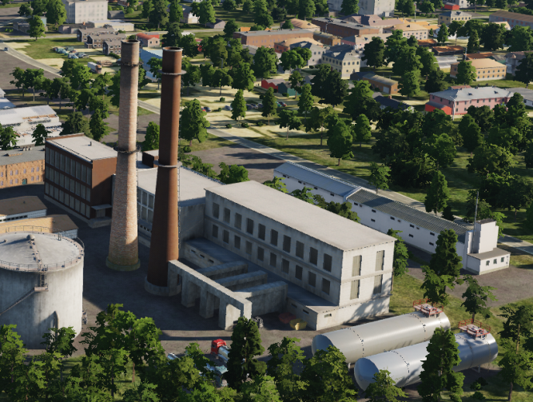
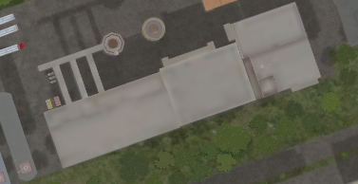
 | 500 IBS | 1000 IBS | 2000 IBS
1x Bomb
2x Bombs
4x Bombs
When destroyed, will be completely wiped from map, and will not give any ruins

Slide 14
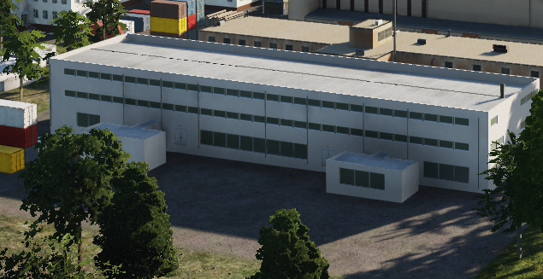
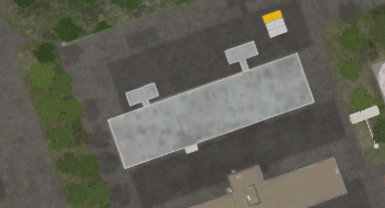
 | 500 IBS | 1000 IBS | 2000 IBS
1x Bomb
2x Bombs
4x Bombs
When destroyed, will be completely wiped from map, and will not give any ruins

Slide 15
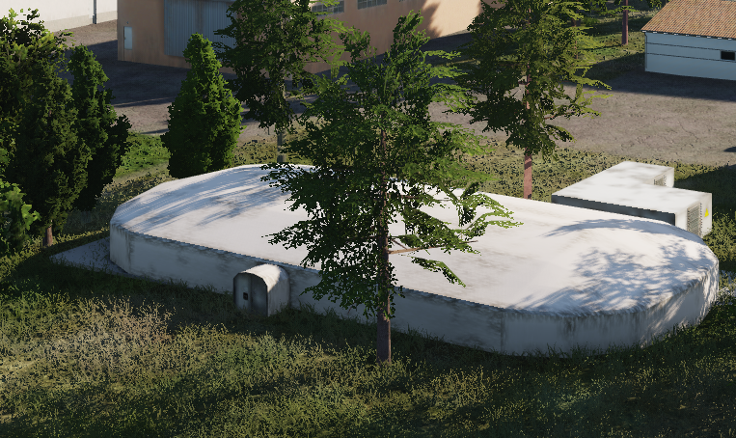
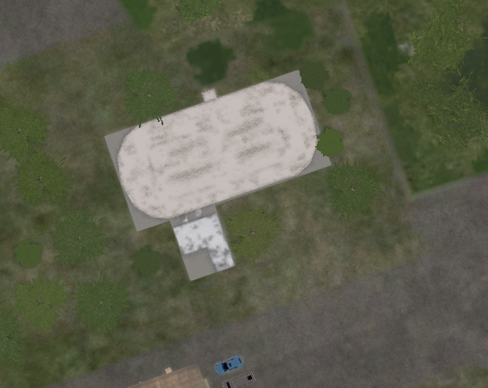
 | 500 IBS | 1000 IBS | 2000 IBS
1x Bomb
2x Bombs
4x Bombs
When destroyed, will be completely wiped from map, and will not give any ruins

Slide 16
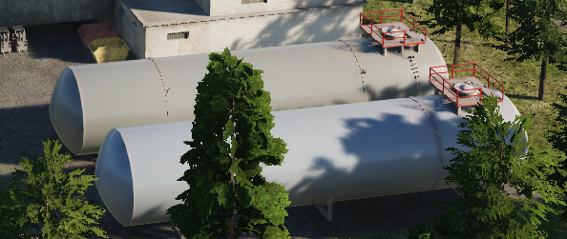
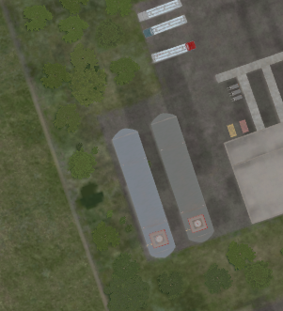
 | 500 IBS | 1000 IBS | 2000 IBS
1x Bomb
2x Bombs
4x Bombs
Gives ruins

Slide 17
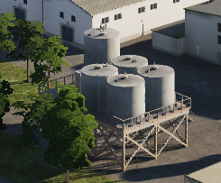
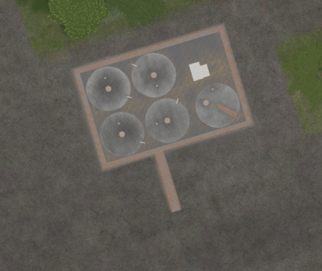
 | 500 IBS | 1000 IBS | 2000 IBS
1x Bomb
2x Bombs
4x Bombs
Gives ruins

Slide 18
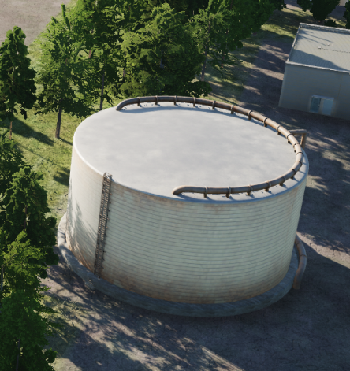
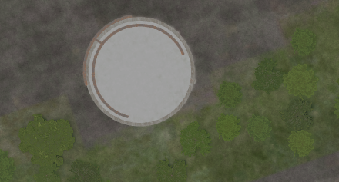
 | 500 IBS | 1000 IBS | 2000 IBS
1x Bomb
2x Bombs
4x Bombs
When destroyed, will be completely wiped from map, and will not give any ruins

Slide 19
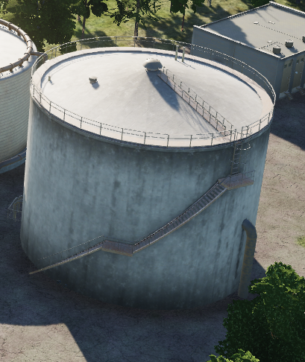
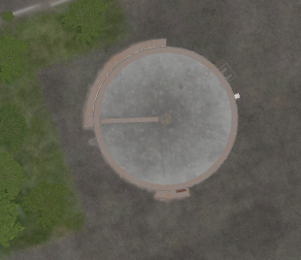
 | 500 IBS | 1000 IBS | 2000 IBS
1x Bomb
2x Bombs
4x Bombs
Gives ruins

Slide 20
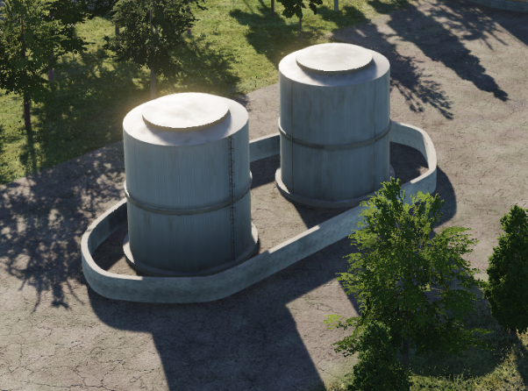
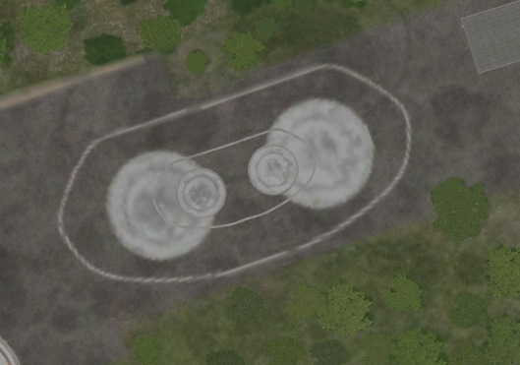
 | 500 IBS | 1000 IBS | 2000 IBS
1x Bomb
2x Bombs
4x Bombs
Gives ruins

Slide 21
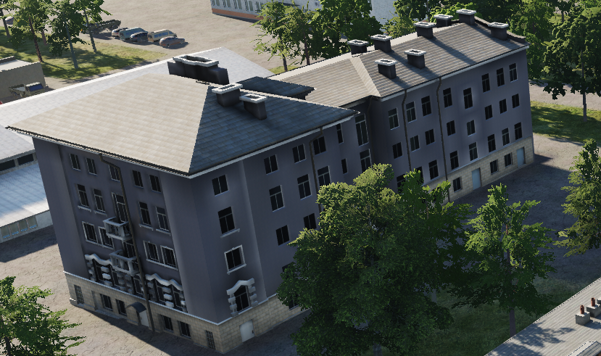
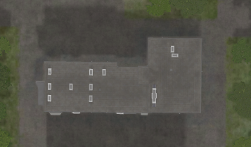
 | 500 IBS | 1000 IBS | 2000 IBS
1x Bomb
2x Bombs
4x Bombs
When destroyed, will be completely wiped from map, and will not give any ruins

Slide 22
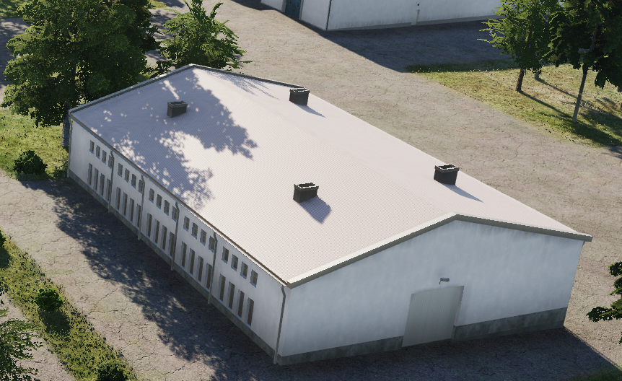
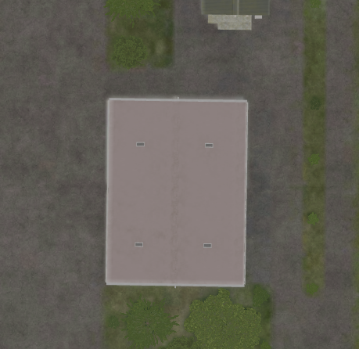
 | 500 IBS | 1000 IBS | 2000 IBS
1x Bomb
2x Bombs
4x Bombs
Gives ruins

Slide 23
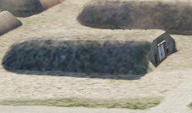
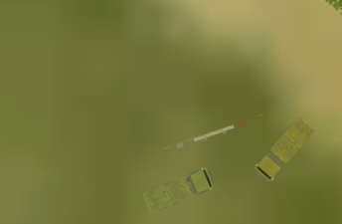
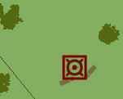

 | 500 IBS | 1000 IBS | 2000 IBS
1x Bomb
2x Bombs
4x Bombs
When destroyed, will be completely wiped from map, and will not give any ruins
But will give ”fireworks” /secondary explosions

Slide 24
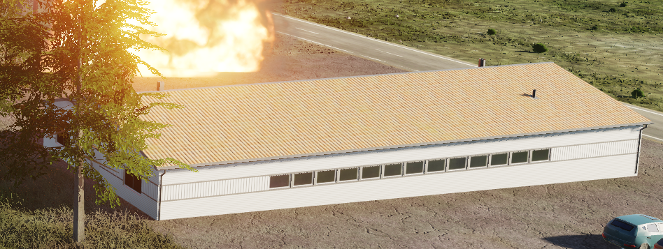
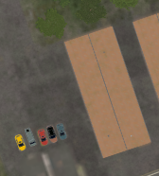
 | 500 IBS | 1000 IBS | 2000 IBS
1x Bomb
2x Bombs
4x Bombs
When destroyed, will be completely wiped from map, and will not give any ruins

Slide 25
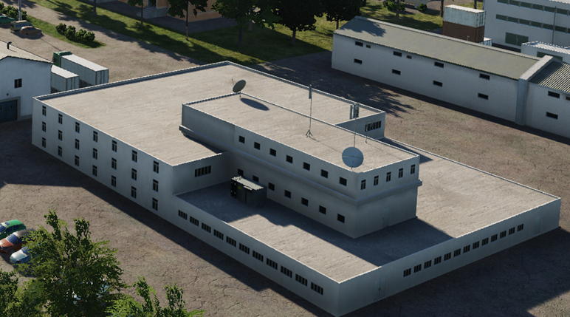
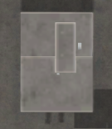
 | 500 IBS | 1000 IBS | 2000 IBS
1x Bomb
2x Bombs
4x Bombs
When destroyed, will be completely wiped from map, and will not give any ruins

Slide 26
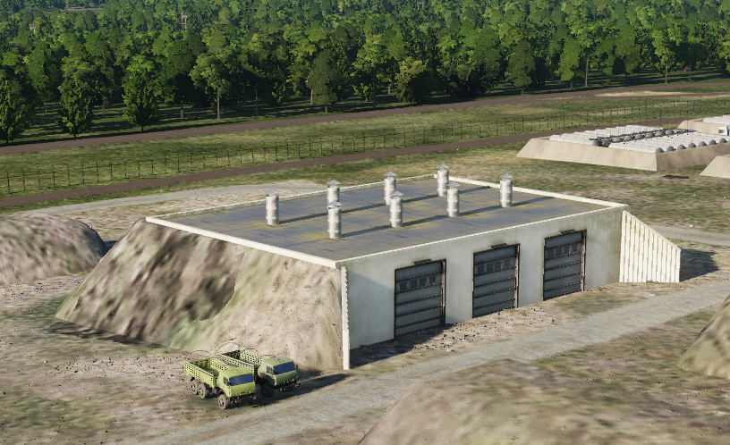
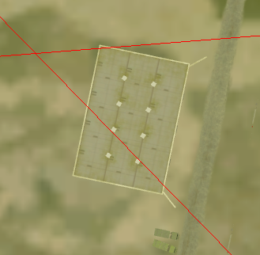
 | 500 IBS | 1000 IBS | 2000 IBS
1x Bomb
2x Bombs
4x Bombs
When destroyed, will be completely wiped from map, and will not give any ruins
But will give ”fireworks” /secondary explosions

Slide 27


 | 500 IBS | 1000 IBS | 2000 IBS
1x Bomb
2x Bombs
4x Bombs
INDESTRUCTABLE

Slide 28


 | 500 IBS | 1000 IBS | 2000 IBS
1x Bomb
2x Bombs
4x Bombs
INDESTRUCTABLE

Slide 29


 | 500 IBS | 1000 IBS | 2000 IBS
1x Bomb
2x Bombs
4x Bombs
INDESTRUCTABLE

Slide 30


 | 500 IBS | 1000 IBS | 2000 IBS
1x Bomb
2x Bombs
4x Bombs
INDESTRUCTABLE

Slide 31


 | 500 IBS | 1000 IBS | 2000 IBS
1x Bomb
2x Bombs
4x Bombs
INDESTRUCTABLE

Slide 32


 | 500 IBS | 1000 IBS | 2000 IBS
1x Bomb
2x Bombs
4x Bombs
INDESTRUCTABLE

Slide 33


 | 500 IBS | 1000 IBS | 2000 IBS
1x Bomb
2x Bombs
4x Bombs
INDESTRUCTABLE

Slide 34


 | 500 IBS | 1000 IBS | 2000 IBS
1x Bomb | x
2x Bombs | x
4x Bombs | x
INDESTRUCTABLE

Slide 35
UNDER TESTING AFTER THIS

Slide 36
 | 500 IBS | 1000 IBS | 2000 IBS
1x Bomb
2x Bombs
4x Bombs

Slide 37
UNVERIFIED after this

Slide 38

 | 500 IBS | 1000 IBS | 2000 IBS
1x Bomb
2x Bombs
4x Bombs

Slide 39

 | 500 IBS | 1000 IBS | 2000 IBS
1x Bomb
2x Bombs
4x Bombs
 | 500 IBS | 1000 IBS | 2000 IBS
1x Bomb
2x Bombs
4x Bombs

Slide 40

 | 500 IBS | 1000 IBS | 2000 IBS
1x Bomb
2x Bombs
4x Bombs

Slide 41


 | 500 IBS | 1000 IBS | 2000 IBS
1x Bomb
2x Bombs
4x Bombs

Slide 42

 | 500 IBS | 1000 IBS | 2000 IBS
1x Bomb
2x Bombs
4x Bombs

Slide 43

 | 500 IBS | 1000 IBS | 2000 IBS
1x Bomb
2x Bombs
4x Bombs

Slide 44

 | 500 IBS | 1000 IBS | 2000 IBS
1x Bomb
2x Bombs
4x Bombs

Slide 45

 | 500 IBS | 1000 IBS | 2000 IBS
1x Bomb
2x Bombs
4x Bombs

Slide 46

 | 500 IBS | 1000 IBS | 2000 IBS
1x Bomb
2x Bombs
4x Bombs
COMMENT: AFTER TESTING IT SEEMS NOT TO BE POSSIBLE TO DESTROY (2024-12-29)
NOTE: Also destructable with 20mm cannon

